Slide 1

1.4 Data Extraction & Processing - II
© London Academy of IT, www.londonacademyofit.co.uk

Slide 2
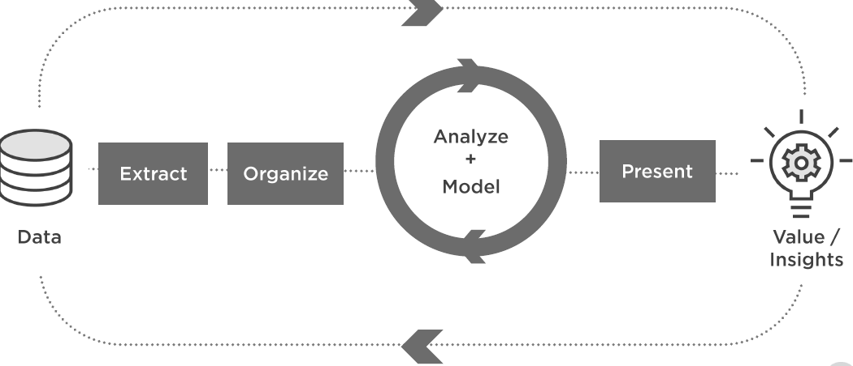
Project Life Cycle

Slide 3
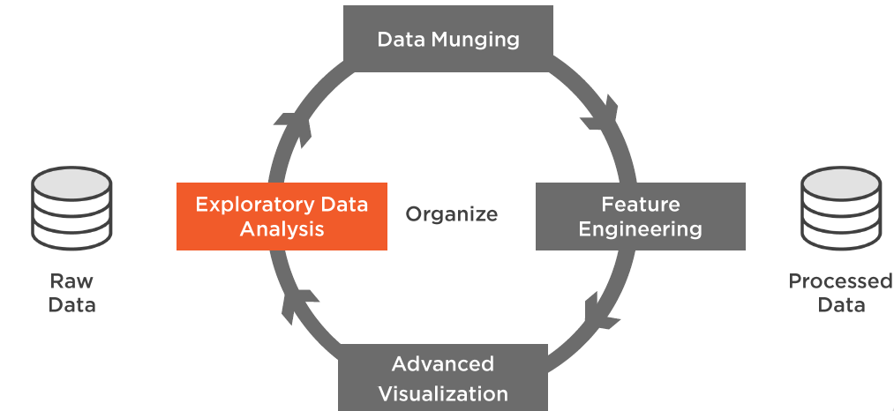
Organize

Slide 4
Data Analysis
Distributions
Grouping
Crosstabs
Pivots

Slide 5
Data Analysis
Distributions
Grouping
Crosstabs
Pivots

Slide 6
Distributions
Univariate
Bivariate
Histogram
Kernel Density Estimation (KDE) plot
Scatter plot

Slide 7
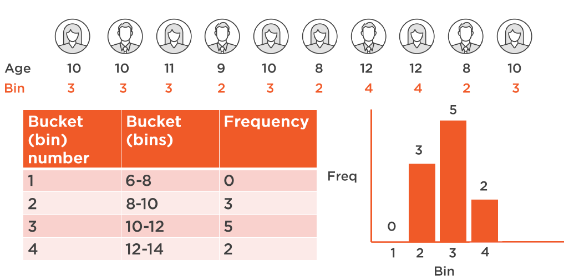
Histogram

Slide 8
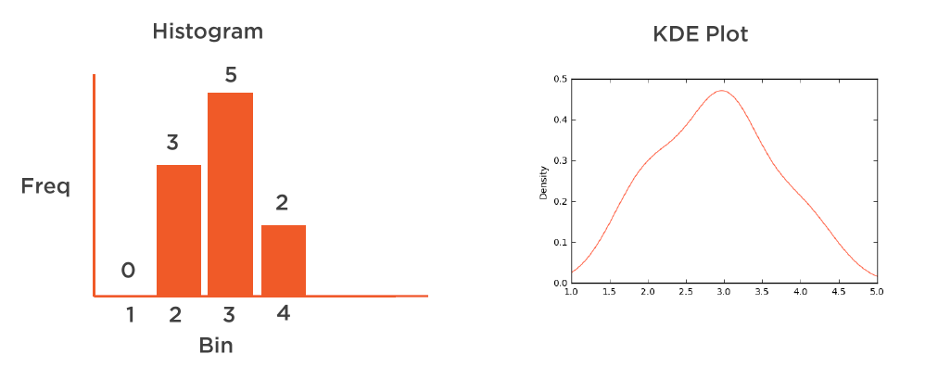
Kernel Density Estimation (KDE) Plot

Slide 9
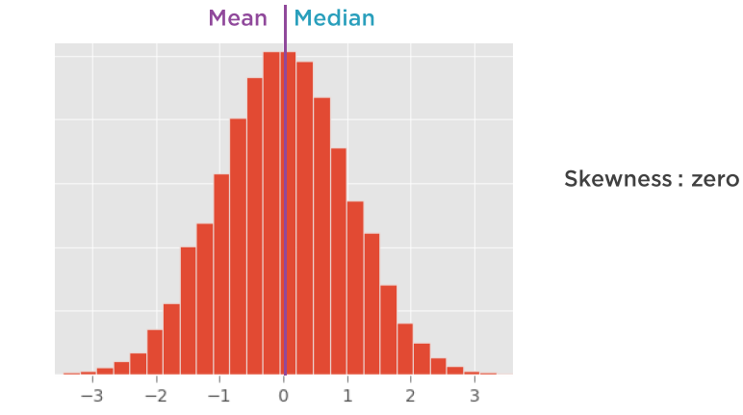
Normal Distribution

Slide 10
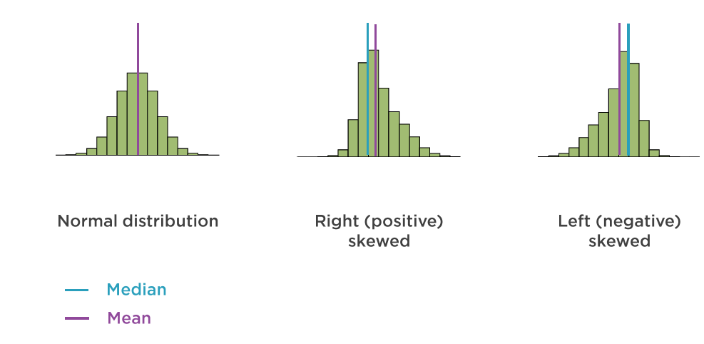
Univariate Distribution - Skewness

Slide 11

Univariate Distribution - Demo
Demo

Slide 12
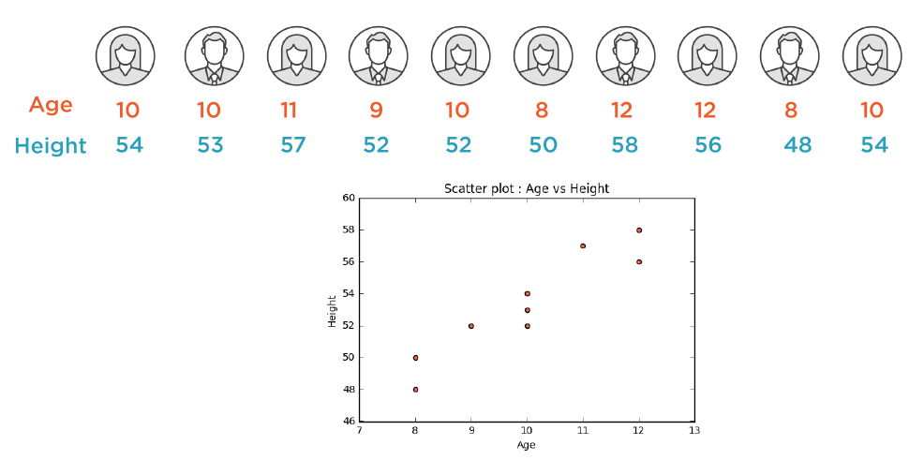
Scatter Plot

Slide 13
Scatter Plot - Demo
Demo

Slide 14
Data Analysis
Distributions
Grouping
Crosstabs
Pivots

Slide 15
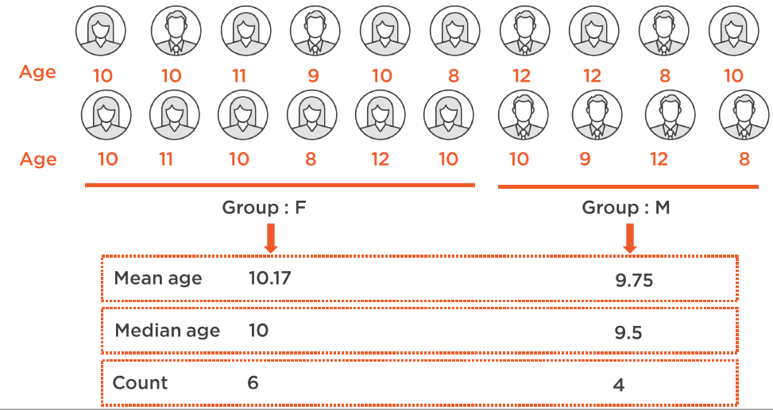
Grouping

Slide 16
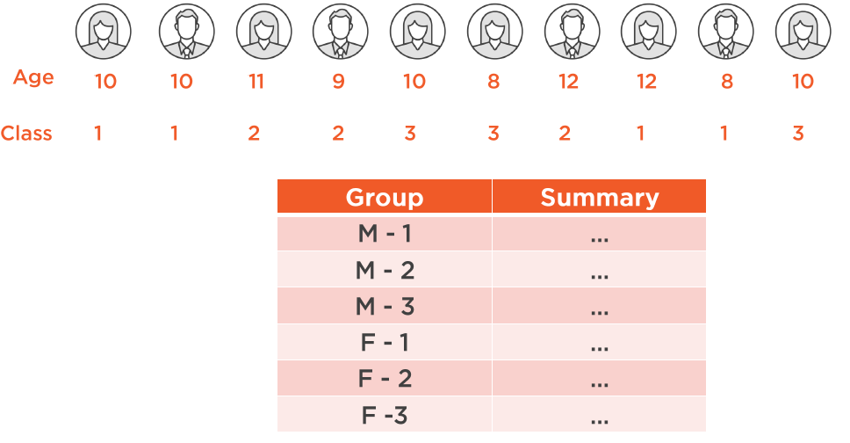
Grouping

Slide 17
Grouping - Demo
Demo

Slide 18
Data Analysis
Distributions
Grouping
Crosstabs
Pivots

Slide 19
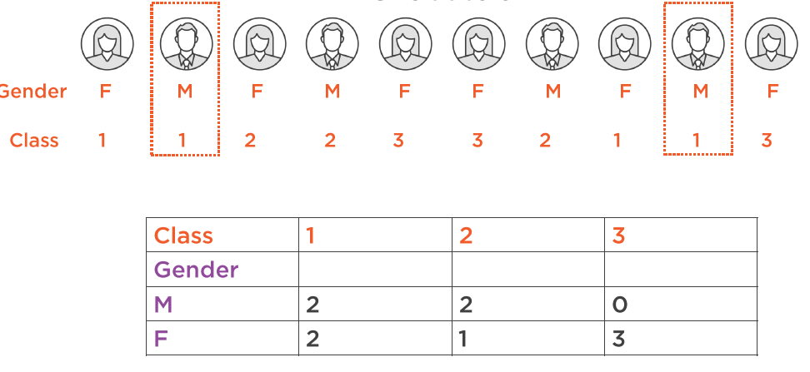
Crosstab

Slide 20
Crosstab - Demo
Demo

Slide 21
Data Analysis
Distributions
Grouping
Crosstabs
Pivots

Slide 22
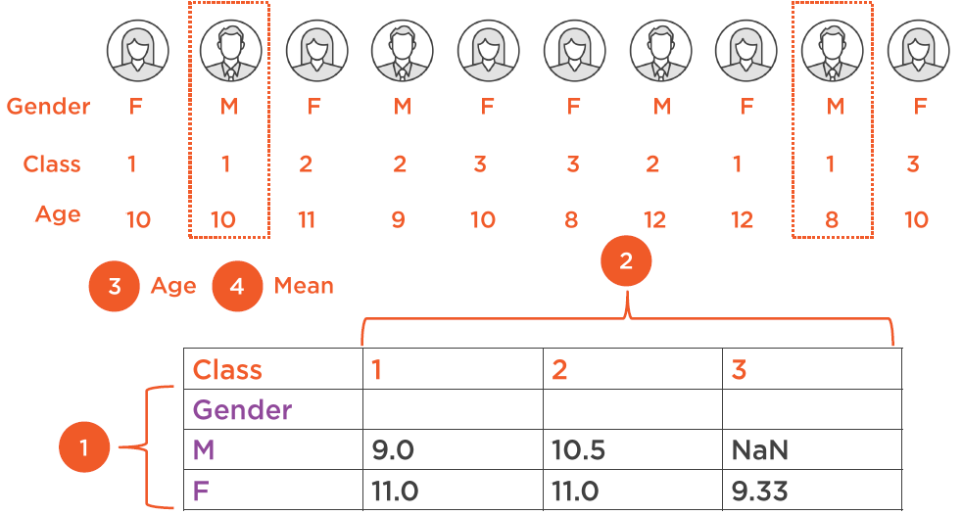
Pivot Table

Slide 23
Pivot table - Demo
Demo

